Slide 1
Building a rotation syllabus using LEGOs: Learning Experience Goals & Objectives SFSHP Pharmacy Residency Preceptors Forum
Radhan Gopalani, Pharm.D., BCPS
Cardiology Clinical Pharmacy Coordinator
radhang@baptisthealth.net

Slide 2
Announcement & Disclosure
In order to prevent bias, we acknowledge:
No commercial support
No conflicts of interest that influence content
To confirm participation, attendance is:
Verified via sign-in sheet
To earn credit, you must:
Attend the entire presentation
Submit an evaluation form

Slide 3
Learning Objectives
Describe the ASHP residency standard 3.3c1 pertaining to learning experience syllabus requirements
Review the key elements of a sample LE syllabus (e.g., description, preceptor information, learner expectations/progression, learning objectives/activities, evaluations/feedback)
Explain how to effectively develop or build a LE syllabus

Slide 4
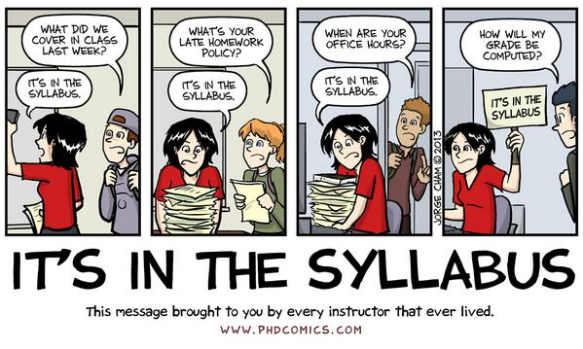

Slide 5
What is a Syllabus?
Also known as learning experience (LE) description
An important document for both preceptor and learner
Tool for communicating the rotation
Introduction to a course of study or LE
Summary or outline of important factors
Indicator for what a learner can expect and what will be expected of them
Notes:
A syllabus serves as the “road map” that shows a student how to get to the “destination”. Building an effective learning experience often depends on how well you map out the details of the rotation. You will address many important issues when shaping the rotation in order to provide the best experience for your student pharmacist. These issues range from establishing the schedule for the rotation to planning activities that will engage the student and facilitate meeting the rotation’s goals and objectives.

Slide 6
Goals of a Syllabus/ LE Description
Serve as a preceptor’s checklist
Set the stage for rotation
Inform/educate trainee of expectations
Simplify and standardize orientation process
Reduce repetitive explanations of assignments to learners
Serve as a repository for the rules and regulations that govern the LE
Dynamic document that can be amended when new learning opportunities identified

Slide 7
Building Blocks: [ASHP standard 3.31(a,b,c,d,e)]
General description
Pharmacist’s role in practice area
Expectations of a learner/trainee
Preceptor role and resident progression
LE goals/objectives assigned to rotation
Learning activities and assignment that will facilitate achievement of each educational objective
Evaluations to be completed by preceptors & residents and respective timeline

Slide 8
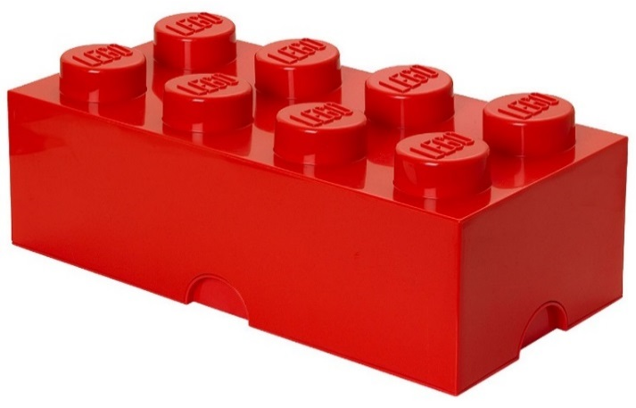
General Description:
Type of LE/rotation (elective or required)
Duration for LE
Preceptor information: Phone/email
Tour of duty/schedule of activities
Description of practice area: Number of beds, types of patients/disease states, acuity level, etc.
Description of day to day responsibilities/operations: Multidisciplinary rounds, patient interaction, medication histories, chart reviews, core measure assessments, etc.
Attendance and role in pertinent committees/meetings
Formal and informal topic discussions and literature review
Development of specialized clinical skills

Slide 9
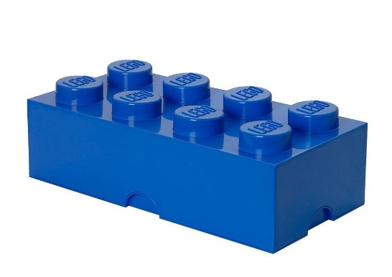
Pharmacist’s Role:
Can be derived from job description with specific delineations for given area of practice
Can be in a bullet format or paragraph style
Examples:
Responsible for MTM of ------patient care unit, focus on streamlining MTM for Pts with a variety of --------------conditions transitioned from various levels of care
Facilitate compliance with ---------core measure medications & address --------risk factors through pharmacotherapy to prevent secondary events
Perform daily prospective chart reviews & participates in multidisciplinary rounds for -----------patients
Ensure resolution of identified MTM concerns with stake-holders , recommend evidence-based, safe & cost-effective medication regimens, monitor & reports ADRs & medication errors, provide medication education
Actively engage with & serves as a clinical resource to healthcare team members; provides support & guidance to operational pharmacists
Ensure formulary management & stewardship are facilitated through the use of therapeutic substitution protocols & initiatives promote rational drug therapy selection
Get involved in drug information retrieval/dissemination, PI initiatives, staff education activities & development programs to enhance patient care outcomes for neurological disease states as well as pharmacy department services

Slide 10
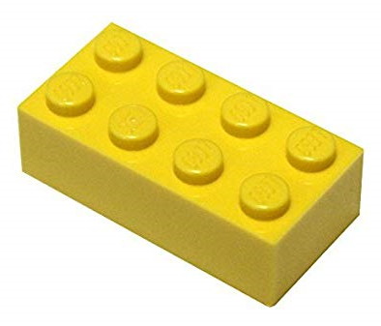
Expectations of a Learner:
Must be in line with intended outcomes to be achieved upon completion of LE
Must be specific, measurable, attainable, realistic, and timely (SMART)
Should go hand in hand with expected progression of training/rotation
Shall help struggling learners to seek out assistance before it is too late to correct the underlying issue
Examples:
Perform the roles fulfilled by an experienced clinical neurology specialist as detailed previously
Active & effective participation as modeled by their preceptor in multidisciplinary patient care rounds
Resident is expected to demonstrate efficiency in prioritizing acute care of Pts.
Resident will gradually assume responsibility of all Pts. within assigned units
Mentor/co-precept APPE students in training during this learning experience, as applicable
Review pertinent policies & procedures, protocols to ensure familiarity with common interventions
Assignments & special projects must be completed by the assigned due date

Slide 11
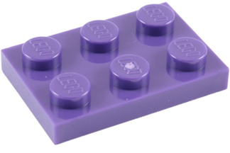
Learner Progression:
Describe the expected progression over the course of the rotation
helps establish milestones for the trainees so that their self-evaluations can be based on your expectations and not on their own assumptions
Can be broken down into days or weeks
Should specifically describe types of activities & level of independence the learners should be achieving at various points in LE

Slide 12
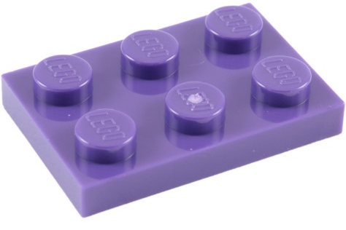
Preceptor Role/Resident Progression
Day 1: Preceptor to review rotation syllabus, learning objectives/activities, schedule, assigned reading, projects, and overall expectations. Preceptor will discuss & explain (direct instructions) the role of a specialist pharmacist & their routine functions and responsibilities including but not limited to …………………as it relates to the rotation
Week 1: Preceptor will demonstrate (modeling) effective participation in …….. and resident will observe their role in the ………….
Week 2: Preceptor will supplement any missed opportunities (coach) to help improve residents' performance
Week 3-4: Preceptor may attend and observe the resident's participation in …or may expect a report from the resident regarding….. and use of recommendations made by the resident. Preceptor will be available (facilitating) for questions, will monitor ……….independently to assess resident skill development in all aspects of LE and will facilitate the resident as the pharmacist
The length of time the preceptor & resident spend in each of the teaching/learning phase is
subject to customization and will depend BOTH on the resident's progressions in the current rotation and where the rotation falls in the residency program schedule

Slide 13
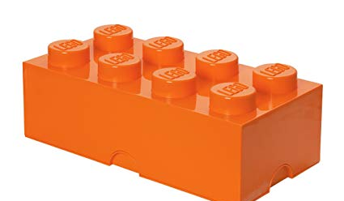
Objectives
Description of knowledge, skills or behaviors you want your resident to exhibit at the end of your rotation and/or activity
Written with action verbs (describe, calculate, demonstrate)
Provide guidance in planning activities & assessing resident progress
Provide trainee with expectations
Should be specific, clear, and measurable
Feasible for given practice area, rotation structure and duration
Limited in # (not excessive)
Preceptor should work closely with the residency program director to identify goals and objectives that should be taught and evaluated during a rotation

Slide 14
Required Goals/Objectives PGY-1 Pharmacy Residency Training (33)
Competency Area R1: Patient Care
12 objectives
Competency Area R2: Advancing Practice and Improving Patient Care
9 objectives
Competency Area R3: Leadership and Management
6 objectives
Competency Area R4: Teaching, Education, and Dissemination of Knowledge
6 objectives

Slide 15
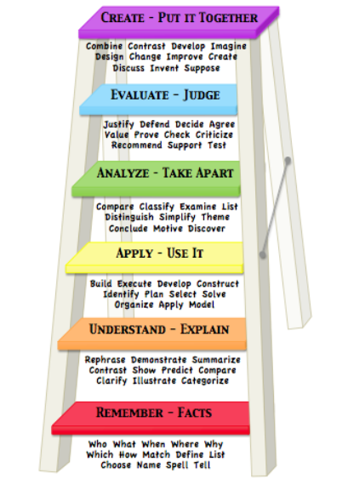
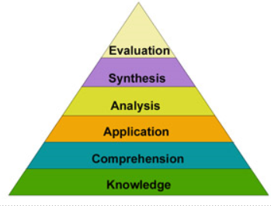
Bloom’s Taxonomy (History)
Intended to develop classification method for thinking behaviors important
in process of learning
Spearheaded by Benjamin Bloom
Multi‐tiered classification model of levels of cognitive complexity
Depicted as a stairway or a pyramid
Hierarchical
Provides an important framework for preceptors to focus on higher
order thinking
Can assist preceptors in:
Designing performance tasks & assessments
Providing feedback

Slide 16
Levels of Bloom’s Taxonomy:
Remembering Information: Knowledge; recalling facts & information
Understanding: Comprehension, explaining the meaning of information
Applying: Using learned knowledge in new situations or to solve a real life problem
Analyzing: Breaking down a whole into component parts; examining critically
Creating: Putting ideas together to form a new & different whole
Evaluating: Making judgments about the merits of ideas, materials, or phenomena based on criteria

Slide 17
Cognitive Domain: Recall
Knowledge (Remembering): Exhibits memory of previously learned material by recalling fundamental facts, terms, basic concepts & answers about the selection
Keywords: who, what, why, when, omit, where, which, choose, find, how, define, label, show, spell, list, match, name, relate, tell, recall, select
--------------------------------------------------------------------------------------------------------------------------------------------------------
Comprehension (Understanding): Demonstrate understanding of facts & ideas by organizing, comparing, translating, interpreting, giving descriptors & stating main ideas
Keywords: compare, contrast, demonstrate, interpret, explain, extend, illustrate, infer,
outline, relate, rephrase, translate, summarize, show, classify

Slide 18
Cognitive Domain: Interpretation
Applying: Solve problems in new situations by applying acquired knowledge, facts, techniques & rules in a different, or new way
Keywords: apply. build, choose, construct, develop, interview, make use of, organize, experiment, with, plan, select, solve, utilize, model, identify
---------------------------------------------------------------------------------------------------------------------------------------------------------
Analyzing: Examine & break information into parts by identifying motives or causes. Make
inferences & find evidence to support generalizations
Keywords: analyze, categorize, classify, compare, contrast, discover, dissect, divide, examine, inspect, simplify, survey, test for, distinguish, list, distinction, theme, relationships, function, motive, inference, assumption, conclusion, take part in

Slide 19
Cognitive Domain: Problem-solving
Creating: Compile information together in a different way by combining elements in a new pattern or proposing alternative solutions
Keywords: Build, choose, combine, compile, compose, construct, create, design, develop, estimate, formulate, imagine, invent, make up, originate, plan, predict, propose, solve, solution, suppose, discuss, modify, change, original, improve, adapt, minimize, maximize, theorize, elaborate, test, happen, delete
------------------------------------------------------------------------------------------------------------------------------------------------------------------------------
Evaluating: Present & defend opinions by making judgments about information, validity of ideas or
quality of work based on a set of criteria
Keywords: award, choose, conclude, criticize, decide, defend, determine, dispute, evaluate, judge,
justify, measure, compare, mark, rate, recommend, rule on, select, agree, appraise,
prioritize, opinion, interpret, explain, support importance, criteria, prove, disprove,
assess, influence, perceive, value, estimate, deduct

Slide 20
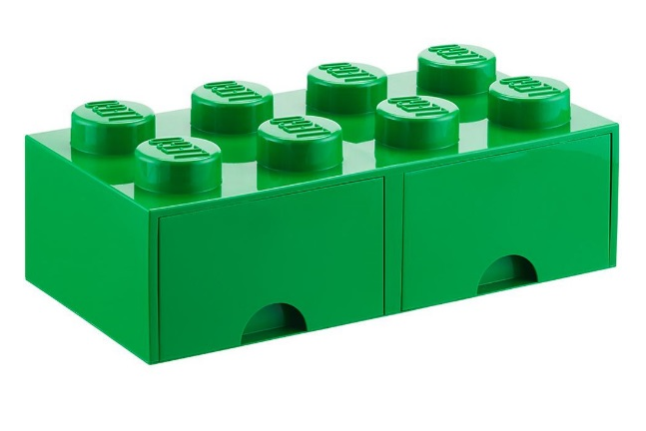
Activities and Assignments:
Must facilitate active learning
Promote achievement of the rotation’s goals and objectives
Be mapped to the corresponding learning objective
Require learner to formulate answers to questions based upon knowledge
Encourages learner to ask new questions and continue to search for new
knowledge to provide better, more complete answers
Develops critical thinking and problem-solving skills
If any activities occur during off-hours (meeting in the evening, etc.) , make this expectation clear

Slide 21
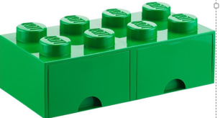
Example of Activities (Understanding)
Management Principles:
Participate in discussions with Rx Director on assigned topics: e.g., governance of the healthcare system & leadership roles; quality metrics; changes to laws & regulations as related to medication use; & keeping current on trends in pharmacy & healthcare
Participate in discussions with Rx Director on topics: e.g., basic principles of management; financial management of a pharmacy; accreditation, legal, regulatory, & safety requirements applicable to the site; facilities design; culture of the organization; the organization’s political & decision-making structure; & the strategic planning process
Complete required readings prior to assigned topic discussions

Slide 22
Example of Activities (Applying)
Interact effectively with health care teams to manage patients’ medication therapy
While on rounds, be prepared to identify medication-related problems & make evidence-based recommendations for solutions to the team
Participate in daily rounds with assigned team & provide recommendations on assigned patients & answer drug information questions in a timely manner
Work with physicians & nurses to resolve issues found when reconciling patients’ medications prescribed on admission with medications taken as outpatient. Contact prescribing physician to resolve issues found when verifying medication orders
Work with nurses & other health care providers to resolve missing doses & other medication distribution issues brought to your attention while staffing

Slide 23
Example of Activities (Analyzing)
Collect information on which to base safe & effective medication therapy
Collect pertinent information on each assigned Pts. from medical record, RN, & Pt. or caregiver (as applicable) daily prior to rounds & record pertinent data on a patient monitoring form
Gather all pertinent Pt.-specific information in an organized manner & be prepared to discuss recommendations with preceptor & interdisciplinary team during rounds & daily preceptor meetings
Review INR’s, medical record, & interview patients before altering warfarin therapy
Perform a med history, review medical record, & contact Pt.’s pharmacy or prescribing physician as needed when performing medication reconciliation. Record discrepancies found & recommendations on medication reconciliation form.
Conduct a med profile review daily on assigned Pts. including a review of medical record & Pts. on rounds, be prepared to identify medication-related problems & make evidence-based recommendations for solutions to the team

Slide 24
Example of Activities (Creating)
Design or redesign safe & effective patient-centered therapeutic regimens & monitoring plans (care plans)
Start patient on a dosing regimen designed to achieve target levels. Determine when levels or other appropriate labs need to be ordered & collect other information from medical record, as applicable, to assess response to therapy & monitor for adverse reactions. Revise regimen as necessary
Be prepared to discuss recommendations for addressing medication therapy issues with preceptor prior to rounds with the interdisciplinary team
Contact prescribing/primary physician with recommended changes to medications or monitoring plans if determine changes are needed based on clinical informatics alerts

Slide 25
Example of Activities (Creating)
Prepare assigned drug class review/monograph for presentation at the Pharmacy & Therapeutics Committee
Revise assigned treatment guideline for consideration by appropriate stakeholders
Develop project proposal & seeking necessary approvals (e.g. IRB, Pharmacy & Therapeutics Committee)

Slide 26
Example of Activities (Evaluating)
Design or redesign safe & effective patient-centered therapeutic regimens & monitoring plans (care plans).
Start patient on a dosing regimen designed to achieve target levels. Determine when levels or other appropriate labs need to be ordered & collect other information from medical record, as applicable, to assess response to therapy & monitor for adverse reactions. Revise regimen as necessary
Be prepared to discuss recommendations for addressing medication therapy issues with preceptor prior to rounds with the interdisciplinary team.
Contact prescribing/primary physician with recommended changes to medications or monitoring plans if determine changes are needed based on clinical informatics alerts

Slide 27
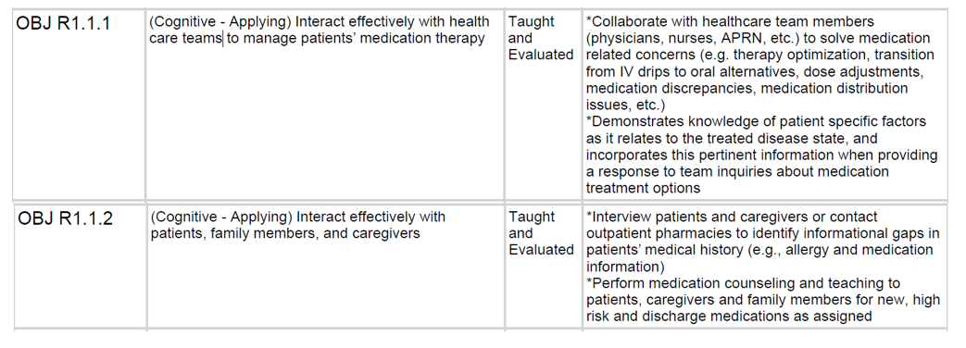
Goals/Objectives and Activities:
Relationship between objectives and activities:

Slide 28
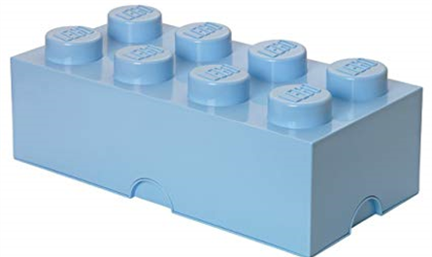
Formative Assessment
Criteria based
Describe knowledge, skills, and attitudes you want demonstrated
Should be able to be used by another instructor/pharmacist/peer/student
Evidence based
What went right
What when wrong
How to get better

Slide 29
Evaluations:
Syllabus should clearly describe how the resident will be evaluated and what acceptable performance looks like
May provide copies of the rubrics used for specific evaluations (e.g., presentation, journal
club, or patient cases, etc. ) before they begin putting these projects together
A brief description of what it takes to earn each rating of the scale utilized (numerical i.e., 1-5 or categorical i.e., needs improvement, satisfactory progress, achieved )
Should be constructive and specific (i.e., sandwich method)
Strengths
Areas to improve
Strengths, with motivating comments
May include verbal or written self assessment
Should include Formative and Summative
Notes:
Remember assessment and feedback go both directions, so don’t get so focused on providing them feedback that your forget to ask for your own! Can relax student and open up communication when they know you’re looking for improvement too.

Slide 30
Feedback Description (Example):
The resident will receive on-going, regular formative verbal feedback throughout the rotation
Preceptor and resident will have a midpoint discussion to assess the overall LE for the resident. The goal for this meeting will be to identify areas on which to focus, future activities, etc., based on resident feedback as well as preceptor identification of areas for improvement
Performance deficits and any other concerns will be communicated at the Residency Advisory Committee meetings

Slide 31
Evaluation Schedule (Example):

Slide 32
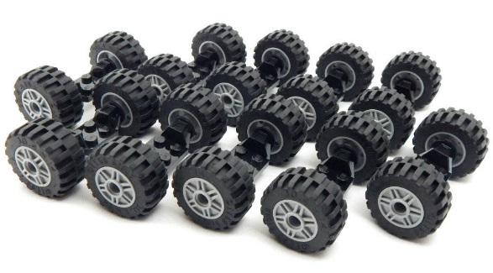
Supplements to Syllabus
Calendar of activities
Guidelines on topic discussion
Guidelines for journal club
Guideline for case presentation
Rubrics utilized for formative evaluations of specific assignments
Guidelines/policies for any pertinent assignments

Slide 33
Calendar of Activities:
A key companion to the formal syllabus document
Lives outside of the actual syllabus
Most used element of a syllabus
Should include:
Scheduled activities (topic discussions, required meetings, presentations, etc.)
Preceptor availability (PTO, offsite activities, meetings, etc.)
Tentative timelines as well as absolute deadlines (first draft vs. final draft reviews)
Assessment dates/times (weekly, mid-point, final, etc.)
Should be updated if changes occur in the planned events/activities

Slide 34
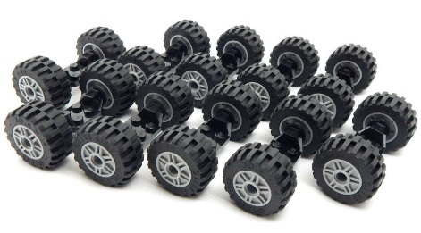
Topic Discussion
Designed to provide a review of selected disease states or conditions
Enhance small-group presentation skills
Formal presentation ~ ------- min (specify duration), focusing on medication therapy management
Inclusive of clinical practice guideline and recent
Should fits with the area of practice of the rotation
Should accompany a complete, yet succinct handout for the attendees
Presentation delivery using presentation skills
Not to be read
Limit to specified time
Must include references

Slide 35
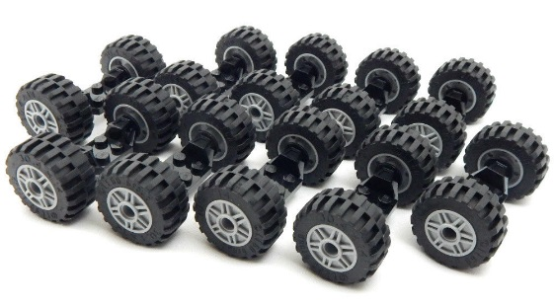
Journal Club
Designed to evaluate the learner’s evidence-based medicine skills
Should identify emerging evidence that might be of use to practicing pharmacists
Help examine studies closely for strengths and weakness to determine the clinical applicability of the data published
Should be a recent journal article of interest, preferably relevant to given filed of rotation
Should be a randomized control trial, although others may be accepted after review and approval by the preceptor
Formal handout should be used for presentation
Can be word document , a Power Point presentation is not necessary, although it may be done if you prefer this delivery method
Email an electronic copy of the journal article to all likely attendees of the journal club
This includes pharmacists, residents, and other students.
On the day of the presentation, arrive prepared with handouts for all likely attendees

Slide 36
Evaluation Rating Scale (Example):
Rating | Definition
Needs Improvement (NI) | Deficient in knowledge/skills in this area Often requires assistance to complete the objective Unable to ask appropriate questions to supplement learning
Satisfactory Progress (SP) | Adequate knowledge/skills in this area Sometimes requires assistance to complete the objective Able to ask appropriate questions to supplement learning Requires skill development over more than one rotation
Achieved (ACH) | Fully accomplished the ability to perform the objective Rarely requires assistance to complete the objective; minimum supervision required No further developmental work needed
Achieved for Residency (ACHR)* | Resident consistently performs objective at Achieved level, as defined above, for the residency.

Slide 37
Completed:

Slide 38
Questions:

Slide 39
References:
Schlesselman, LS. Bloom’s Taxonomy, University of Connecticut, School of Pharmacy: Teaching Certificate Course for Preceptors
O’Sullivan TA, Lau C, Patel M, Mac C et al. Student-valued measurable teaching behaviors of award-winning pharmacy preceptors. Am J Pharm Educ. 2015; 79:151.
Young S, Vos SS, Cantrell M, Shaw R. Factors associated with students’ perception of preceptor excellence. Am J Pharm Educ. 2014; 78:53
Soric, MM. Writing Your Syllabus or Learning Experience Description, chapter 3: https://www.ashp.org/-/media/store-files/p5549-sample-chapter-3.ashx
ASHP Accreditation Standard for PGY-1: https://www.ashp.org/-/media/assets/professional-development/residencies/docs/pgy1-residency-accreditation-standard-2016.ashx?la=en&hash=9FF7C76962C10562D567F73184FAA45BA7E186CB
Residency objectives: https://www.ashp.org/-/media/assets/professional-development/residencies/docs/required-competency-areas-goals-objectives
Example Activities for the 2014 Competencies, Goals, and Objectives: https://www.ashp.org/-/media/assets/professional-development/residencies/docs/learning-activity-examples.ashx

