Slide 1
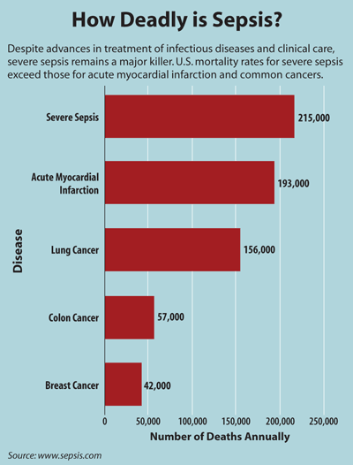
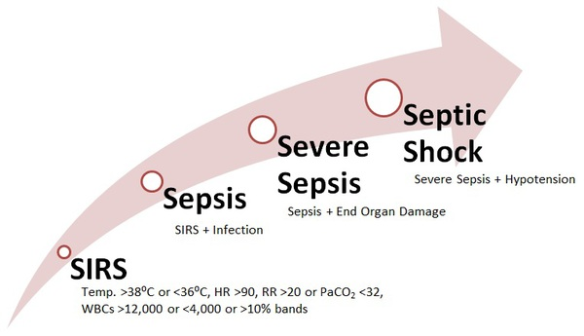
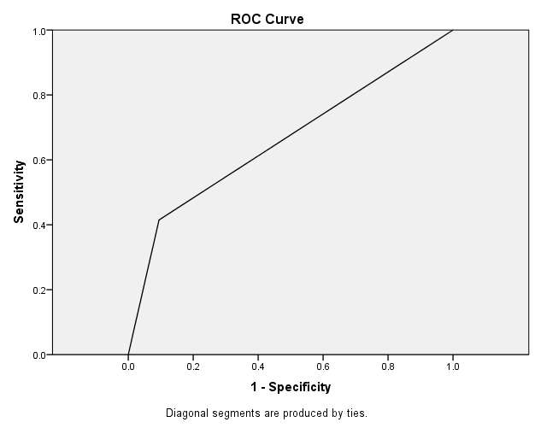
Evaluating the Sensitivity and Specificity of a Severe Sepsis Tool Utilized at a Community Hospital in Miami, Florida
Jorge Hirigoyen APRN-BC
BACKGROUND
RESULTS
Sepsis is the 10th leading cause of death in the United States. The number and rate per 10,000 hospitalizations for sepsis or severe sepsis has more than doubled from 2000 to 2008, with incidence increasing approximately 5-10 % each year.³ Sepsis is also the leading cause of death in the critical care population regardless of multiple innovations in diagnosing and resuscitation therapy. ⁴ Recent approaches have targeted both diagnosing sepsis and rapidly treating those septic patients, thus preventing further decompensation. Accurately identifying sepsis at an early stage can potentially decrease mortality by 5-10%, consequently accentuating the importance of early detection and prompt therapeutic treatment. ⁵ Connecting early sepsis recognition with pathogen identification allows for practitioners to effectively administer proper antibiotic therapy more rapidly, hence decreasing mortality and morbidity. In a merge approach to improve the increasing rate of sepsis and severe sepsis, health care providers have formulated different methods to not only rapidly identify sepsis but also treat it. ⁵ As a result, the Surviving Sepsis Campaign (SSC) was launched in 2004 and a set of guidelines were created for sepsis management.
Since the initial development of the Surviving Sepsis Campaign guidelines published in 2004 outlining the management of severe sepsis and septic shock, there has been an absolute disregard on the management of septic patients in medical surgical units. Currently no unified approach exists to diagnose and treat sepsis in medical surgical units. More recently with the utilization of prognostic biomarkers for sepsis identification there has been more confusion on proper guidelines to treat sepsis in medical surgical units A study conducted by Carter (2007) identified that 29% of mortality occurred in septic patients when a sepsis bundle was implemented within the first 24 hours of admission, versus a 49% mortality when the bundle was implemented after 24 hours or not implemented at all. The same study also indicated the necessity to implement a sepsis screening tool for early sepsis recognition. ² In efforts to improve this pandemic, a Community- Hospital in Miami, Fl adopted a severe sepsis screening tool to rapidly identify severe septic patients in Medical Surgical units. Consequently, clinicians must rely on the sensitivity and specificity of sepsis tools, combination of various biomarkers and clinical presentation to adequately diagnose septic patients.
Sepsis Statistics:
Worldwide there are approximately 18 million new cases of sepsis each year, with a mortality rate range estimated about 30% to 60%. ¹
Sepsis is the 10th leading cause of death in the United States. ³
Organ failure occurred in 19.1 % of sepsis patients from 1979
to 1989 and 30.2% from 1990 to 2000. ⁷
Severe sepsis as the primary diagnosis increased from 326,000
in 2000 to 727,000 in 2008. ³
Severe sepsis as the secondary diagnosis from 621,000 in 2000
to 1,141,000 in 2008. ⁶
About 24 % of patients who develop severe sepsis or septic
shock will do so in a Medical-Surgical unit. ²
A total of 258 chart reviews were performed during phase 1 to evaluate the severe sepsis tool identification percentage. A frequency distribution was utilized, demonstrating that the Severe Sepsis Screening Tool utilized at a Community- Hospital in Miami, Fl identified those patients with sepsis criteria 76 % of the time.
A total of 1555 patients were screened utilizing the severe sepsis screening tool in phase 2. Receiver operating curve (ROC) and the respective area under the curve were calculated. Utilizing a 2x2 design, the sensitivity and specificity of the tool was calculated. One hundred and eighty eight patients were diagnosed with sepsis criteria at time of discharge. Seventy eight screened positive for sepsis syndrome. The study yielded a sensitivity of 41.49%. One thousand three hundred and sixty two patients were not diagnosed with sepsis syndrome at the time of discharge. One thousand two hundred and thirty three screened negative for sepsis. Five patients data were dismissed, because of inability to assess chart. The study yielded a specificity of 90.53%. The positive predictive value (PPV) of the tool was estimated at 37.68%, negative predictive value (NPV) was estimated at 91.81 % and disease prevalence was 12.13%. Area under the receiver operating curve was 0.660.
MATERIALS AND METHODS
Study Design
Descriptive Retrospective Study
The severe sepsis tool utilized at a Community-Hospital in Miami, Florida is an electronic instrument that reports admitted patient information, such as the individual's latest vital signs and laboratory work in order to detect sepsis status. This assessment tool is performed by each nurse every shift, and is only deferred if a patient screens positive for severe sepsis. The screening tool screens for systemic inflammatory response syndrome (SIRS), sepsis, and severe sepsis, based on the definitions provided by the SSC in 2012.
Phase 1
The purpose of Phase 1 was to evaluate the percentage of patients with sepsis criteria utilizing the Severe Sepsis tool. Following IRB approval, information technology ( IT) generated two reports. The first report included patients (N =220) admitted to the pilot unit during 2013 presenting with a diagnosis of systemic inflammatory response syndrome (SIRS), sepsis, and/or severe sepsis (including urosepsis). The second report included patients admitted to the pilot unit during 2013 (N = 38), presenting with a diagnosis other than systemic inflammatory response syndrome (SIRS), sepsis, and/or severe sepsis (including urosepsis). Demographic data and clinical factors were entered into a password protected organization computer accessible to research personnel only.
Phase 2
Phase 2 evaluated the sensitivity and specificity of the Severe Sepsis Tool utilized at a Community- Hospital in Miami, Fl. IT generated a report for the time frame of August 2013 to January 2014 that contained: total number of patients admitted to the pilot unit(N=1555): of those patients total number with discharge diagnosis of sepsis (n=193), total number who screened positive > 1 time during hospital stay (n=78), and total number who screened negative during hospital stay (n=110); there were five missing cases. Receiver operating curve (ROC) and the respective area under the curve were calculated. Utilizing a 2x2 design, the sensitivity and specificity of the tool was calculated.
LIMITATIONS
Limitations to this study include:
Sample Size
Nurse’s implementation and understanding of the
utilization of the tool
Lack of education regarding the tool
Inability to accurately diagnose patients with sepsis
syndrome on admission.
CONCLUSIONS
A two phase retrospective chart review study demonstrated that the severe sepsis screening tool utilized at a Community- Hospital in Miami, Fl has a sensitivity value of 41.49% and a specificity value of 90.53% when evaluating medical surgical patients. These results indicate the tool is accurate in detecting patients that are not septic; however, it was not reliable in identifying patients who are truly septic. The study concluded a positive predictive value of 37.68%.
Further studies need to be conducted to validate the sensitivity and specificity of the severe sepsis tool utilized at Community- Hospital in Miami, Fl in different clinical areas.
Phase 1: Frequency Table
ROC Curve
 |  | Statistics
 |  |  |  |  | Diagnosis on admission | Sepsis Tool Identifies Sepsis
 |  | N |  | Valid | 220 | 220
 |  |  |  | Missing | 0 | 0
 |  | Frequency Table
 |  | Diagnosis On Admission
 |  |  |  |  | Frequency | Percent | Valid Percent | Cumulative Percent
 |  | Valid |  | Yes | 220 | 100.0 | 100.0 | 100.0
 |  | Sepsis Tool Identifies Sepsis
 |  |  |  |  | Frequency | Percent | Valid Percent | Cumulative Percent
 |  | Valid |  | No | 53 | 24.1 | 24.1 | 24.1
 |  |  |  | Yes | 167 | 75.9 | 75.9 | 100.0
 |  |  |  | Total | 220 | 100.0 | 100.0
REFERENCES
PURPOSE
Anderson, R. & Schmidt, R. (2010). Clinical biomarkers in sepsis. Front Bioscience (Elite Edition), 2(5), 504-520
Carter, C. (2007). Implementing the severe sepsis care bundles outside the ICU by outreach. Nursing Critical Care, 12(5), 225-230.
Hall, M. J., Williams, S. J., DeFrances, C, J., & Golosinskiy, A. (2011). Inpatient care for septicemia or sepsis: A challenge for patients and hospitals. Centers for Disease Control and Prevention National Center for Health Statistics, 62, Retrieved from www.cdc.gov/nchs/data/databriefs/db62.pdf.
Sankar, V. & Webster, N. R. (2013). Clinical application of sepsis biomarkers. Journal of Anesthesia, 27, 269-283.
Singer, M. (2013). Biomarkers in sepsis. Current Opinion in Pulmonary Medicine, 19(00), 1-5.
Tazbir, J. (2012). Early recognition and treatment of sepsis in the medical-surgical setting. Medical Surgical Nursing, 21(4), 205-208.
Tromp, M., Tijan, D. H. T., van Zanten, A. R. H., Gielen-Wiffels, S. E. M., Goekoop, G. J. D., Van den Boogaad, M., Wallenborg, C. M., Biemond-Moeniralam, H. S., & Pickkers, P. (2011). The effects of implementation of the surviving sepsis campaign in the Netherlands. Netherlands Journal of Medicine, 69(6), 292-298.
A Severe Sepsis Screening tool was implemented as a pilot study in a Medical-Surgical Unit in 2013 as a Computerized Patient Order Management (CPOM) tool.
The tool was already utilized in ICU, Emergency Department at a Community- Hospital in Miami, Fl.
Problem Statement
The purpose of this pilot study is to evaluate the sensitivity and
specificity of the severe sepsis screening tool utilized at a
Community- Hospital in Miami, Fl for early identification of
septic patients in a Medical-Surgical non- ICU unit.
Research Question
What is the sensitivity and specificity of the severe sepsis screening tool utilized at a Community- Hospital in Miami, Fl
in a Medical-Surge non - ICU unit?
Phase 2: 2x2 Design
 | Sepsis Present | Sepsis Absent
Positive | 78 True Positive | 129 False Positive
Negative | 110 False Negative | 1233 True Negative
Area Under the Curve
Test Result Variable(s):screen
Area
.660
Acknowledgments: Eve Butler and Andrea Prentiss from Baptist Research Department, 4 Tower team. Special thanks to Melanie Santos, Luz Lorenzo, Disney Granado, Katiuska Diaz, Sandra Benitez, Magdely Perez, Viviana Castillo and Ofelia Cabrera .

