Slide 1
Current and Upcoming Stroke Research at Baptist Health
Amy K. Starosciak, Ph.D.
Clinical Research Supervisor
Center for Research and Grants
Baptist Health Neuroscience Center
December 1, 2016

Slide 2
Disclosures
None

Slide 3
Introduction

Slide 4
Neuroscience Disciplines
Neurology
Interventional Neuroradiology
Neurosurgery
Rehab
Nursing
Neuroradiology
Neuro Critical Care

Slide 5
Neuroscience Research Areas
Stroke
Neuro Oncology
Falls
Epilepsy
Spine
Movement Disorders
Rehab
Brain Injury

Slide 6
Types of Research Studies
Sponsored Clinical Trials
Prospective Studies
Retrospective Reviews

Slide 7
Types of Clinical Research
 | Retrospective Reviews | Prospective Studies | Clinical Trials
Purpose | Observational | Observational or interventional | To test safety and efficacy of a new drug, device, or treatment
Principal Investigator (PI) | Doctor, nurse, scientist, or other staff | Doctor, nurse, scientist, or other staff | Doctor (usually)
Funding Source | None | None or Grants | Pharmaceutical or device companies, grants
Data Collection | In the past | Current/ongoing | Current/ongoing
Sample Size | Small to very large | Small to moderate | Moderate to very large
IRB Approval | Required | Required | Required
Informed Consent | May be waived | Required (cover letter or written) | Required (written)
HIPAA Authorization | May be waived | Required | Required
Risk to Benefit Ratio to Patient | Minimal risk (confidentiality), benefit to others | Minimal risk to some risk, may have direct benefit to patient | Moderate to high risk, may have direct benefit to patient
PI-Initiated
Sponsored

Slide 8
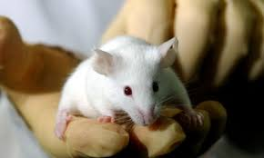
Other Types of Research
Basic science research – provides a foundation of knowledge for the applied science we use in medicine; often a source for new tools, models, and techniques
Laboratory or “bench” research – occurs in a lab, usually involves working with tissues or cells (in vitro)
Preclinical research – occurs in a lab and often involves working with animals (in vivo)

Slide 9
Other Types of Research
Population health research – focused on the health outcomes of groups of individuals
Characterize, explain and/or influence the levels and distributions of health within and across populations
Addresses health outcomes, health determinants, and policies and interventions that link the two
Purpose to improve health and eliminate health disparities
Kindig & Stoddart, 2003

Slide 10
Other Types of Research
Social/behavioral research – study of people’s or animals’ responses to certain stimuli (external and internal)
Conducted by the following academic disciplines: sociology, psychology, anthropology, economics, political science, history
Often uses interviews or questionnaires to collect data
Observational or interventional

Slide 11
BHSF Stroke Research

Slide 12
BHSF Stroke Research
Ischemic Stroke
Intracerebral Hemorrhagic Stroke
Subarachnoid Hemorrhage and Aneurysms
Carotid Occlusions

Slide 13
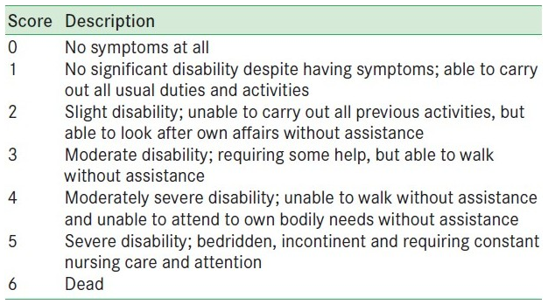
Modified Rankin Scale (mRS)
Commonly used scale to measure degree of disability or dependence in daily activities of people who suffered a stroke
Score 0-2 considered a “good” functional outcome
Typical results in the medical literature is 33-54% of patients score 0-2 at 90 days post IV t-PA or mechanical reperfusion.
Berkhemer et al., 2015; Campbell et al., 2015; Goyal et al., 2015; Jovin et al., 2015; Saver et al., 2015; NINDS, 1995

Slide 14
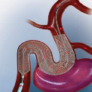
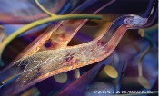
Title | PI(s) | Stroke Type | Type | Purpose
Collection of Data on Interventional Neuro-Radiological Patients for the Purpose of Presentation and Publications | Drs. Linfante & Dabus | All Stroke | PI-Initiated | Retrospective study to examine factors and patient outcomes associated with interventional neuroradiological procedures
HEAT Trial: New Generation Hydrogel Endovascular Aneurysm Treatment Trial | Drs. Linfante & Dabus | Aneurysm | Post-market clinical trial (Northwestern University) | Randomized controlled trial of new generation Hydrogel coils vs. bare Pt coils to treat aneurysms
SCENT Trial: The Surpass IntraCranial Aneurysm EmbolizationN System Pivotal Trial to Treat Large or Giant Wide Neck Aneurysms | Drs. Linfante & Dabus | Aneurysm | Sponsored Trial (Stryker) | Evaluate safety and effectiveness of the Surpass NeuroEndoGraft™ System to treat wide neck, large or giant intracranial aneurysms
WEAVE Trial: Wingspan StEnt System Post MArket SurVEillance Study | Drs. Linfante & Dabus | Carotid | Sponsored Trial (Stryker) | To evaluate the rate of stroke/death within 72 hours in patients treated with the Wingspan Stent System for intracranial atherosclerosis
SCAFFOLD Trial: GORE Carotid Stent Clinical study for the treatment of carotid Artery stenosis in patients at increased risk For adverse events From carOtid enDarterectomy | Drs. Benenati, Dabus, & Linfante | Carotid | Sponsored Trial (Gore) | Evaluate the safety and effictiveness of the GORE® Carotid Stent to treat carotid artery stenosis in patients at increased risk for adverse events from carotid endarterectomy
BARREL Trial: Study of the Reverse Medical Barrel™ Vascular Reconstruction Device (VRD) for Adjunctive Treatment to Embolic Coils for Wide-Neck, Intracranial, Bifurcating/ Branching Aneurysms | Drs. Linfante & Dabus | Aneurysm | Sponsored Trial (Reverse Medical Corporation) | Embolic coils for wide neck aneurysms defined as having a neck width > 4mm or a dome-to neck ratio <2

Slide 15
Title | PI(s) | Stroke Type | Type | Purpose
STRATIS Registry: Systematic Evaluation of Patients TReated With Neurothrombectomy Devices for AcuTe Ischemic Stroke Registry | Drs. Linfante & Dabus | Ischemic Stroke | Sponsored Registry (Covidien) | Registry to evaluate the use of devices in patients diagnosed with an acute ischemic stroke
CREST 2 Trial: Carotid REvascularization and medical managemenr for asymptomatic carotid Stenosis Trial | Drs. Katzen, Linfante, Dabus, Benenati, Tsoukas & Del Conde | Ischemic Stroke | Sponsored Trial (NINDS) | Two parallel studies to assess tx differences between: (1) intensive medical management alone vs. CEA + intensive medical management; (2) intensive medical management alone vs. CAS + intensive medical management
CREST 2 Registry: Carotid REvascularization and medical management for asymptomatic carotid Stenosis Trial | Drs. Katzen, Linfante, Dabus, Benenati, Tsoukas & Del Conde | Ischemic Stroke | Sponsored Registry (NINDS) | Companion the CREST-2 trial and to provide data to the NINDS and CMS for a requested expansion of Medicare coverage for CAS
A comparative analysis of stroke comorbidities in Haitian and non-Haitian populations of South Florida | Drs. Barratt, Starosciak, & Lozano | All Stroke | PI-Initiated/ Medical student project | Identify stroke comorbidities and characterize stroke presentation in the Miami Haitian population vs. the general Miami population
iDEF Trial: Intracerebral hemorrhage DEFeroxamine trial | Drs. Gonzalez-Arias & Fuentes | Intracerebral Hemorrhage | Sponsored Trial (NINDS) | Assess safety and effectiveness of IV deferoxamine vs. saline control
Effects of ethnicity and prior depression on hospital course, treatment, and outcomes in first-time stroke patients | Dr. Starosciak & Neuro Research Team | All Stroke | PI-Initiated | Retrospective review of BHM GWTG data to determine how ethnicity and prior depression affect patient outcomes
Spanish Translation and Validation of the Simplified Modified Rankin Questionnaire | Drs. Starosciak & Lozano, Neuro Research Team | All Stroke | PI-Initiated | Translate the simplified modified Rankin Scale questionnaire (smRSq) instrument to Spanish and assess qualitatively the similarity of the two

Slide 16
Depression and Stroke
Stroke Population
Non-Hispanic
Hispanic
Depression
No Depression
Depression
No Depression
ID by reported Hispanic ethnicity, may be able to characterize further by Mexican, Puerto Rican, Cuban, or other
ID by previous hx of depression, and/or admitted on antidepressants, and/or discharged with antidepressants

Slide 17
Effects of Ethnicity, Depression, and Initial NIHSS on LOS
#
NH-D < H-D = H-ND = NH-ND (3.7 d vs. 6.3-6.9 d; #p=0.06)
Effect lost when NIHSS used as covariate

Slide 18
Effects of Ethnicity and Depression on Disposition
 | Prior depression |  | No prior depression
Disposition | Hispanic | Non-Hispanic | Hispanic | Non-Hispanic
Home | 12 (57%) | 6 (67%) | 93 (53%) | 60 (62%)
Rehab | 4 (19%) | 2 (22%) | 37 (21%) | 15 (16%)
SNF | 3 (14%) | 0 (0%) | 18 (10%) | 9 (9%)
Hospice | 0 (0%) | 0 (0%) | 8 (5%) | 5 (5%)
Expired | 1 (5%) | 1 (11%) | 14 (8%) | 7 (7%)
Other | 1 (5%) | 0 (0%) | 4 (3%) | 1 (1%)
Of the 301 patients, 171 (57%) were discharged home
Hispanic patients were less likely to be discharged home (54%) than non-Hispanic patients (62%), regardless of depression
Results not statistically significant (p=0.16)

Slide 19
Discharge modified Rankin Scale Scores
Of 279 patients that had a discharge mRS score, 98 (35%) had a good clinical outcome (mRS 0-2)
Only 25% of H-D patients had mRS 0-2 vs. 30-40% of patients in the other groups
Results not statistically significant (p=0.16)

Slide 20
Next Steps
Request use of the FL-PR Collaboration to Reduce Stroke Disparities database
Re-submit AHA/ASA Young Investigator Database Research Seed Grant proposal

Slide 21
Intracerebral Hemorrhage Deferoxamine Trial (iDEF)
Prospective, multi-center, double-blind, randomized, placebo-controlled, Phase II Trial
ICH on plain CT w/in 24 h of symptom onset, ages 18-80
32 mg/kg/d x 3 d IV deferoxamine mesylate
90-d mRS ≤ 2
SAEs
90-d mRS > 2
SAEs
3 d IV saline placebo
90-d mRS ≤ 2
SAEs
90-d mRS > 2
SAEs
Randomization
180-d all-cause mortality

Slide 22
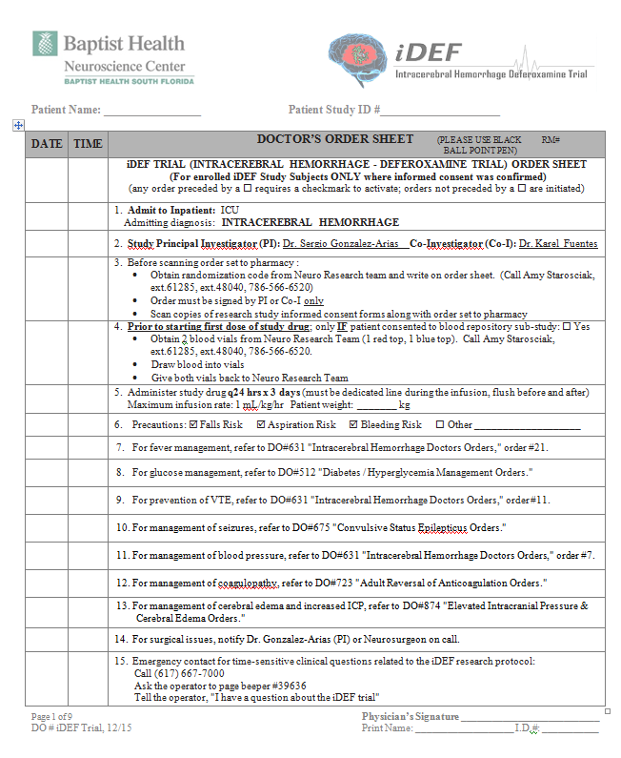
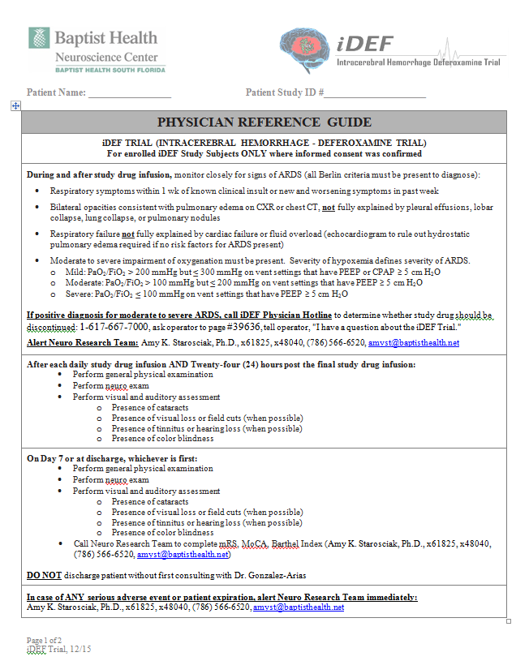

Slide 23
iDEF Screening
Screened ~40 patients August-October 2016
No candidates

Slide 24
Research Collaboratives

Slide 25
Research Collaboratives
NIH StrokeNet Miami Regional Coordinating Center
Florida-Puerto Rico Collaboration to Reduce Stroke Disparities (UM)

Slide 26
NINDS Stroke Net
https://www.nihstrokenet.org
Used with permission from Miami RCC

Slide 27
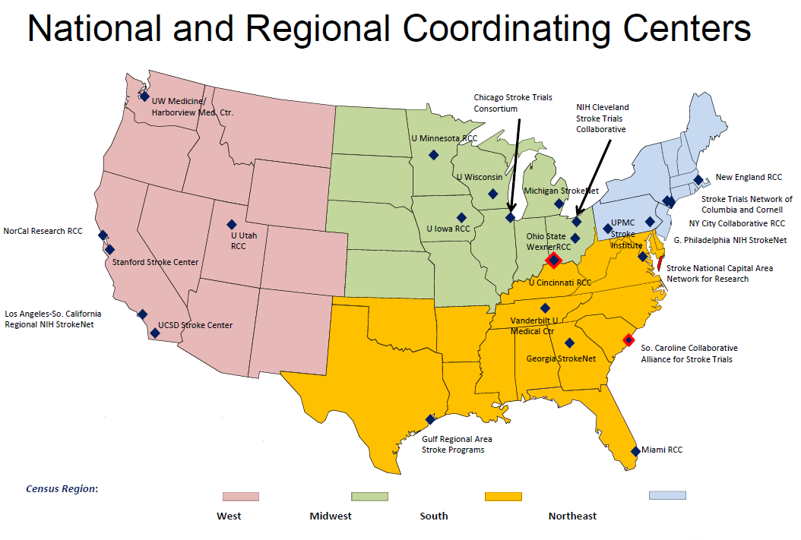
NIH StrokeNet
https://www.nihstrokenet.org Used with permission from Miami RCC

Slide 28
NIH StrokeNet
National Clinical Coordinating Center University of Cincinnati
National Data Coordinating Center MUSC
Miami RCC Executive Committee
Ralph Sacco, M.D.
Jose Romano, M.D.
Tatjana Rundek, M.D.
Miami RCC Sites
Jackson Health: JMH, JMH Rehab, Holtz
University of Miami: UMH, Neuro
JFK Medical Center, JEM Research Inst.
BHSF
VA Medical Center
Miami Children’s
University of South Fl.
University of Florida
Sarasota Memorial
Brooks Rehab Hosp.
Program Manager
Iszet Campo-Bustillo
Lead Coordinator
Andrea Escobar
Training Program
Tatjana Rundek, M.D.
Trainee
https://www.nihstrokenet.org Used with permission from Miami RCC

Slide 29
Ongoing StrokeNet Trials
https://www.nihstrokenet.org

Slide 30
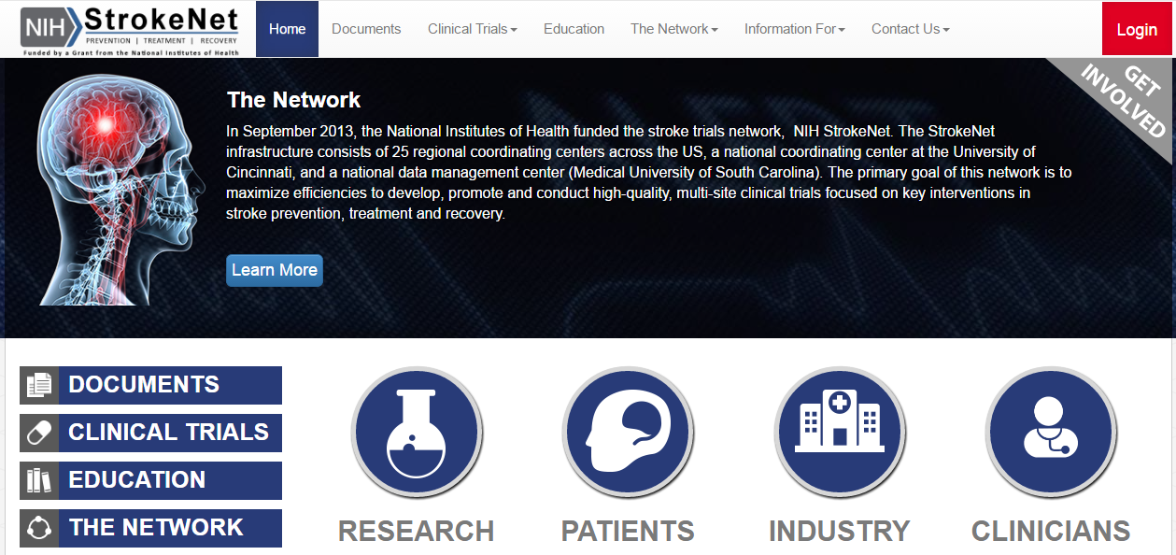
StrokeNet Website
http://nihstrokenet.org

Slide 31
Florida-Puerto Rico Registry
Voluntary stroke registry
Takes advantage of data already collected through the quality improvement initiative Get With The Guidelines-Stroke
http://reducestrokedisparities.org

Slide 32
Florida-Puerto Rico Registry
Evaluate disparities in stroke care by race, ethnicity, and geographic region
Analyze frequency of disparities at 30-d after a stroke in terms of outcomes (mortality, hospital readmission, stroke recurrence), medication adherence, and lifestyle modifications
Evaluate frequency of disparities in longer-term outcomes (mortality, hospital readmission, stroke recurrence) among Medicare patients and the relationship of such outcomes with acute stroke performance metrics
http://reducestrokedisparities.org

Slide 33
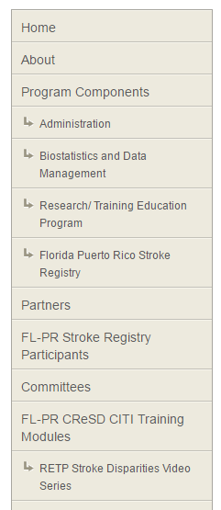
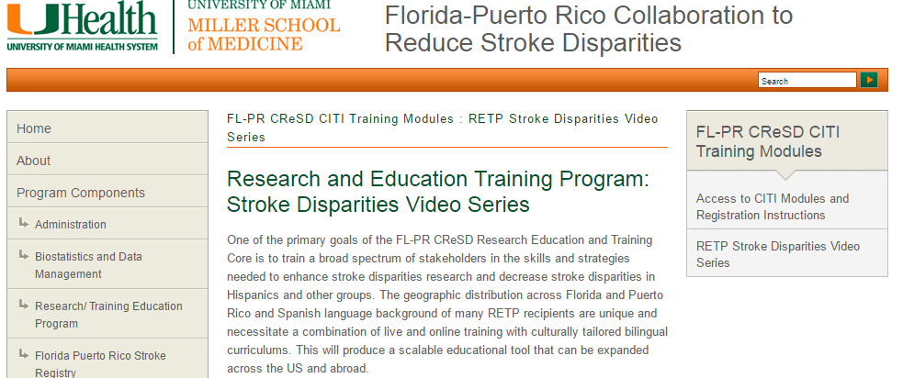
Florida-Puerto Rico Registry
Implement education programs with a focus on identifying and implementing specific culturally-tailored quality improvement programs to address disparities.
http://reducestrokedisparities.org

Slide 34
Conclusions
PI-Initiated Studies
Clinical Trials
Learn about your patient population and answer a specific scientific question
Tend to be smaller scale to effect change in your institution
Can be extrapolated to a larger population
Tend to be less complex to carry out because you design the study
Test safety and efficacy of new drugs and devices
Tend to be large scale to see results in a wide population
Tend to have complex protocols and procedures

Slide 35
Research is formalized curiosity. It is poking and prying with a purpose.
Zora Neale Hurston, Dust Tracks on a Road: an Autobiography (1984)
Notes:
An American novelist, short story writer, folklorist, and anthropologist, whol lived from 1891-1960. Best known for 1937 novel Their Eyes Were Watching God.

