Slide 1
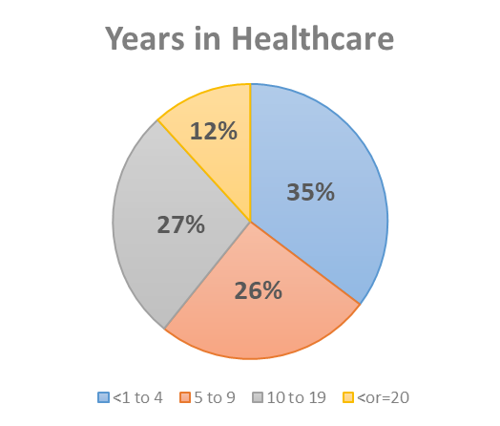
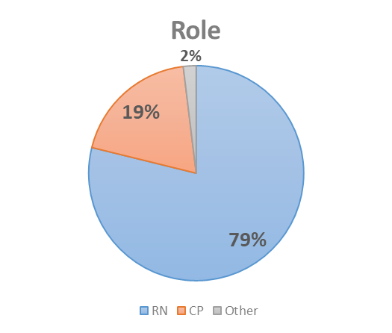
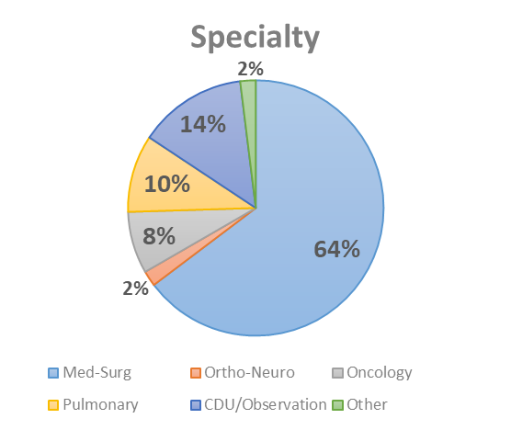
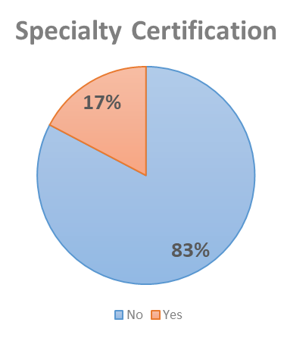
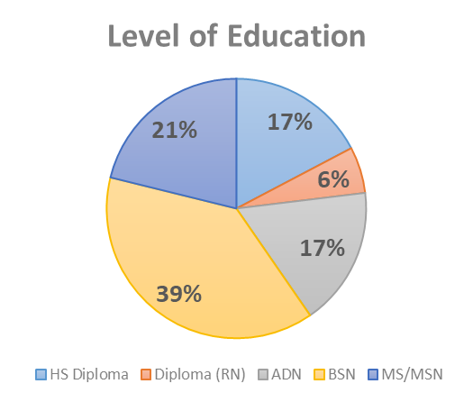
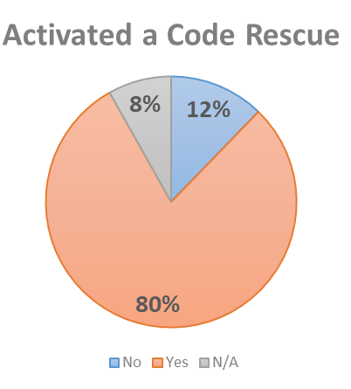
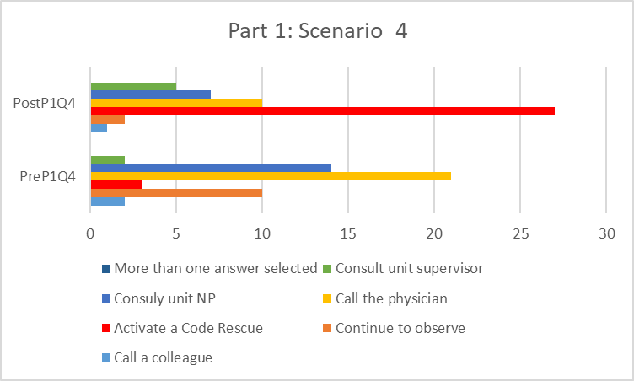
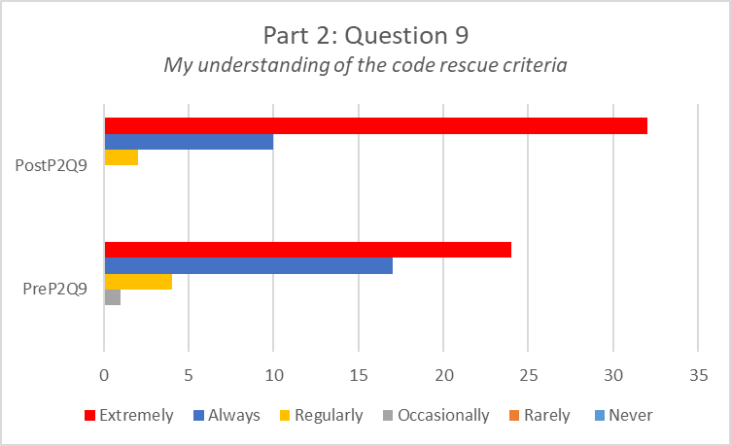
Empowering Nurses to Activate Rapid Response Teams through Knowledge/Confidence-Building using In Situ Simulation
Elicia Egozcue*, MSN, AGPCNP-BC, CNRN, SCRN, CV-RN, NPD-RN │Marrice King, MSN, RN, NPD-BC, CNOR-E, CHSE │Natalie Bermudez, PhD, RN, PCCN-K
RESEARCH
BACKGROUND/SIGNIFICANCE
METHODS
When a patient is noted to have a significant change from baseline some nurses consult with unit Nurse Practitioner (supervisor, or charge nurse) while others will call the Physician for orders rather than activate the Rapid Response Team (RRT)
The most common barrier identified in activating the RRT was Physician or Healthcare Provider response
In Situ Simulation (ISS) is known to assist with retention of new knowledge as it involves attachment of an emotion related to an event to strengthen memory recall
Scripting provides nurses with the words to use when faced with a challenging situation
ISS combined with scripting provides the opportunity to demonstrate confidence in the face of a stressful situation
Participant Characteristics (n = 52):
Years @ SMH: M = 5.41; SD = 5.29 (range = 0 to 21)
Statistically significant differences between pretest and posttest average scores (higher scores on the posttest)
Suggests participants reported increased knowledge and confidence after the In Situ simulation
*Statistical significance: p < .05
Ϯ Approaching statistical significance
PURPOSE
The purpose of this study is to evaluate the effectiveness of using simulation and clinical scripting scenarios on nurses’ confidence in initiating code rescue and nurse-physician communication.
Open-Ended Responses – Practice Changes following In Situ Simulation Participation:
“Confidently discuss with physician when questioned why code was called”
“Being more confident and not afraid of calling a code”
“It makes us less worry about when to call a code rescue and reassure us that it is better to be safe”
“Be more empowered to call a code rescue”
RESEARCH QUESTION
What is the impact of In Situ simulation with clinical scripting on nurses’ confidence and knowledge related to deteriorating patient conditions and timely activation of Code Rescues?
DISCUSSION / CONCLUSION
METHODS
Activating Code Rescues: Increased Confidence & Knowledge
Results of this study suggest the following:
Participants' knowledge and confidence increased following participation in In Situ simulation
Participants felt more confident and empowered to make future decisions regarding when to call a Code Rescue
Participants reported more confidence in communicating with physicians
Limitations:
Single-center study; small sample size
Response biases: demand characteristics & social desirability
Recall bias
Conclusion:
Increasing staff’s knowledge and confidence in early activation of Code Rescues prevents failure to rescue.
Increased availability of In Situ simulation sessions and research studies are recommended.
A future study using In Situ simulation including use of virtual reality is underway.
Design: Cross-sectional quantitative pretest/posttest
Sample/Setting: Medical-surgical registered nurses (RN) at SMH (target minimum, n = 26)
Recruitment: RNs recruited via email, posted flyers, and personal invitation
Instrument/Survey: Rapid Response Team Survey (RRTS) (reliable and valid) – 3 Parts
  Part 1: 4 items (scenarios for knowledge assessment)
  Part 2: 10 items (Likert-type self-report confidence/attitudes assessment)
  Part 3: Demographic information
Procedure:
  Informed consent Written informed consent to participate provided prior to participation
  Pretest administered: RRTS (Parts 1, 2, & 3)
  Orientation to the simulation setting / scenario followed by participation in the scenario and debriefing
  Posttest: RRTS (Parts 1 & 2 only)
Results showed an increase of favorable responses of “Activate a code rescue” for scenarios 1, 2, 4 (only scenario 4 is shown here)
Results showed an increase in participants’ self-reported confidence and knowledge for all Part 2 questions (only Question 9 is shown here)
Data Analysis: Pearson’s Correlation, Dependent t test
IRB Approval: November 1, 2019
Data Collection: July 2021 through November 2021
References available upon request
*Corresponding Author: ElisiaE@BaptistHealth.net

